Slide 1

Aspiring Mind Employment Outcome (AMEO) Dataset
Prepared By – Sheetal Gadpade

Slide 2
Objective:
This analysis endeavours to uncover nuanced insights and correlations within the dataset, emphasizing the intricate interplay between different features and the primary target variable, Salary, with the goal of elucidating underlying trends and informing data-driven decision-making processes.
Summary of Dataset:
The Aspiring Mind Employment Outcome 2015 (AMEO) dataset, provided by Aspiring Minds, offers insights into employment outcomes for engineering graduates. It comprises several dependent variables, including Salary, Job Titles, and Job Locations, alongside standardized scores in cognitive skills, technical skills, and personality skills. With approximately 40 independent variables and 4000 data points, the dataset encompasses a diverse range of continuous and categorical data. Additionally, demographic features and unique identifiers for each candidate are included, contributing to the comprehensive nature of the dataset. The AMEO dataset serves as a valuable resource for analysing the relationship between various predictors and employment outcomes, facilitating informed decision-making and potential insights into factors influencing career trajectories among engineering graduates.

Slide 3
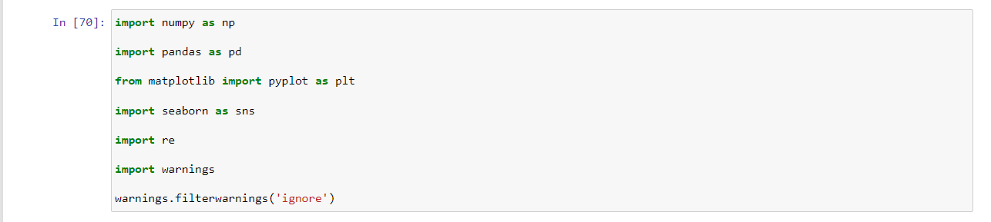

Importing Required Libraries
Shape of Dataset

Slide 4
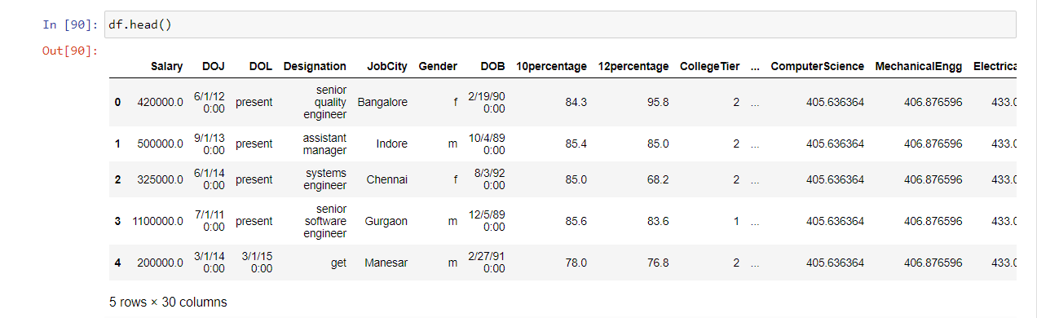
Top 5 Rows of the Dataset
Note :
You can find all statistical information and correlation between the columns in my GitHub Link

Slide 5
Exploratory Data Analysis
Step 1: Data Cleaning
• Removing Unwanted Columns
• Data Type Conversion
• Collapsing Categories
Step 2: Data Manipulation
• Imputing Categorical column with mode values
• Validating 10, 12 percentage, and College GPA
• Checking the condition of DOL > DOJ
• Imputing Numerical Columns with median value

Slide 6
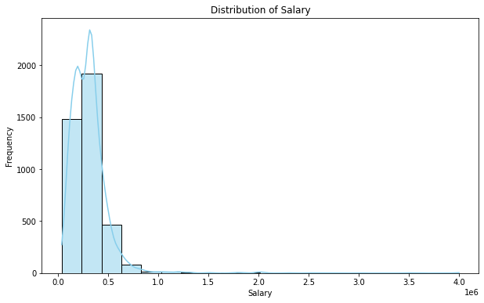
Univariate Analysis
Descriptive Statistics for Salary:
count 3.998000e+03
mean 3.076998e+05
std 2.127375e+05
min 3.500000e+04
25% 1.800000e+05
50% 3.000000e+05
75% 3.700000e+05
max 4.000000e+06
Name: Salary, dtype: float64
Insights :
Most of the graduates having salaries under 5 lakhs.
Long tail of distribution is longer on right hand side as compared to left hand side
which shows that distribution is positively skewed.

Slide 7
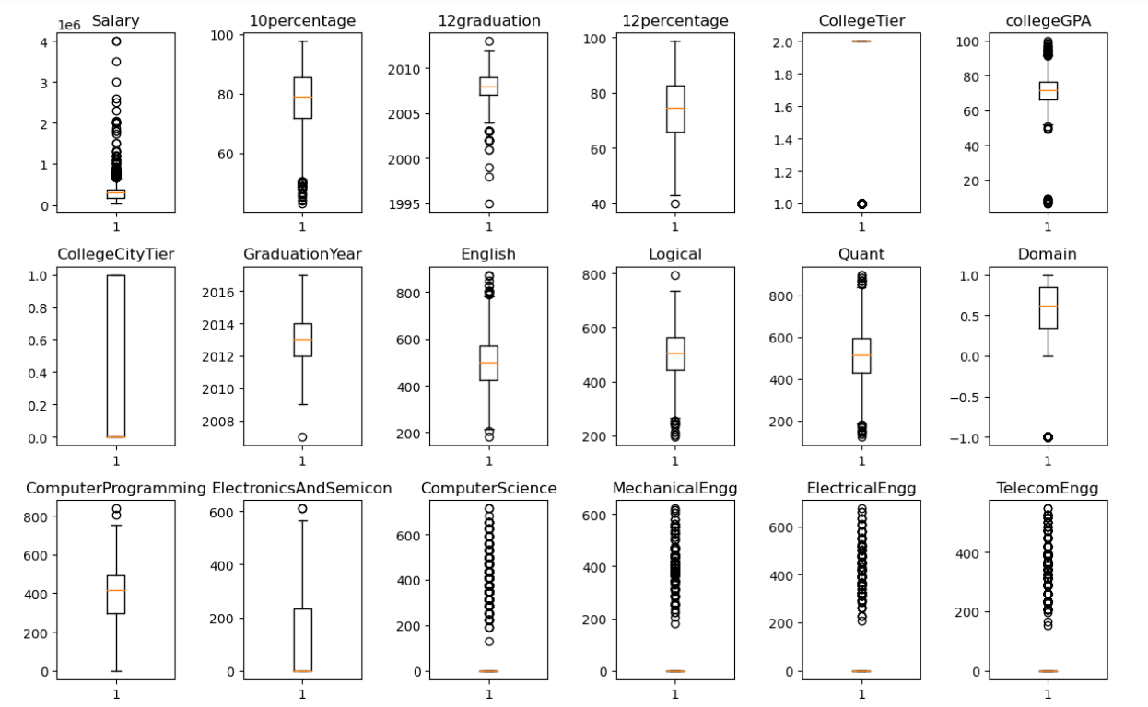
Finding the outliers in each numerical column

Slide 8
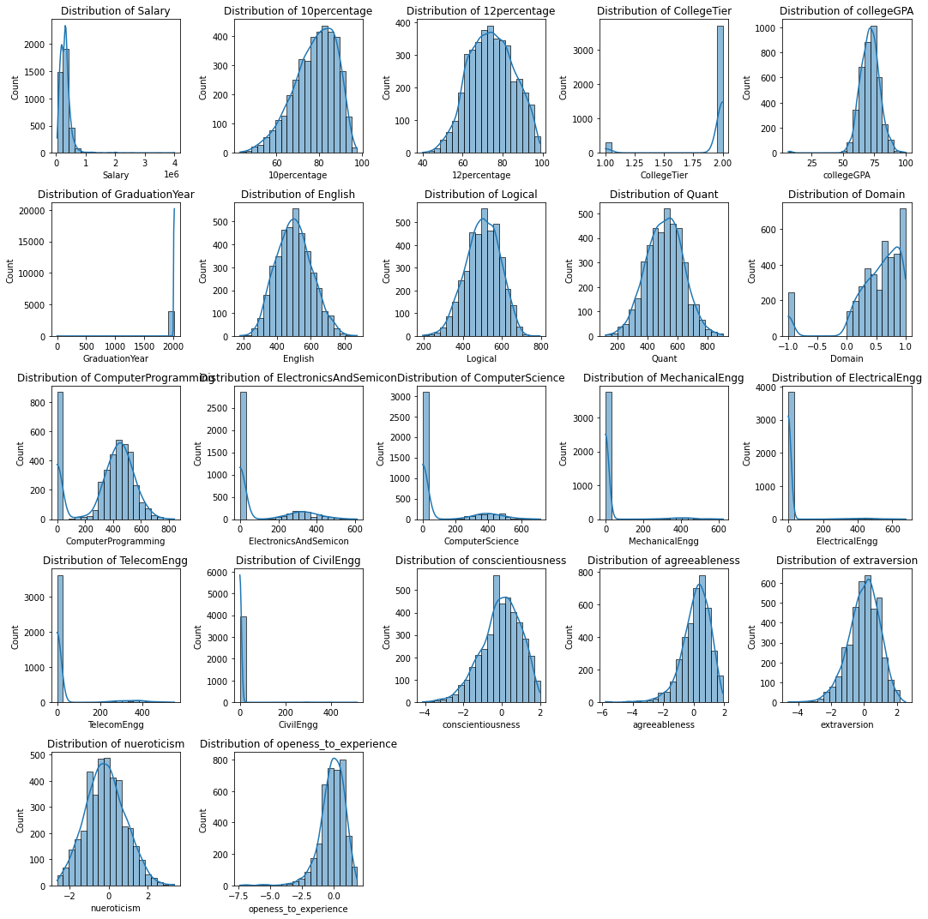
Understanding the probability and frequency distribution of each numerical column

Slide 9
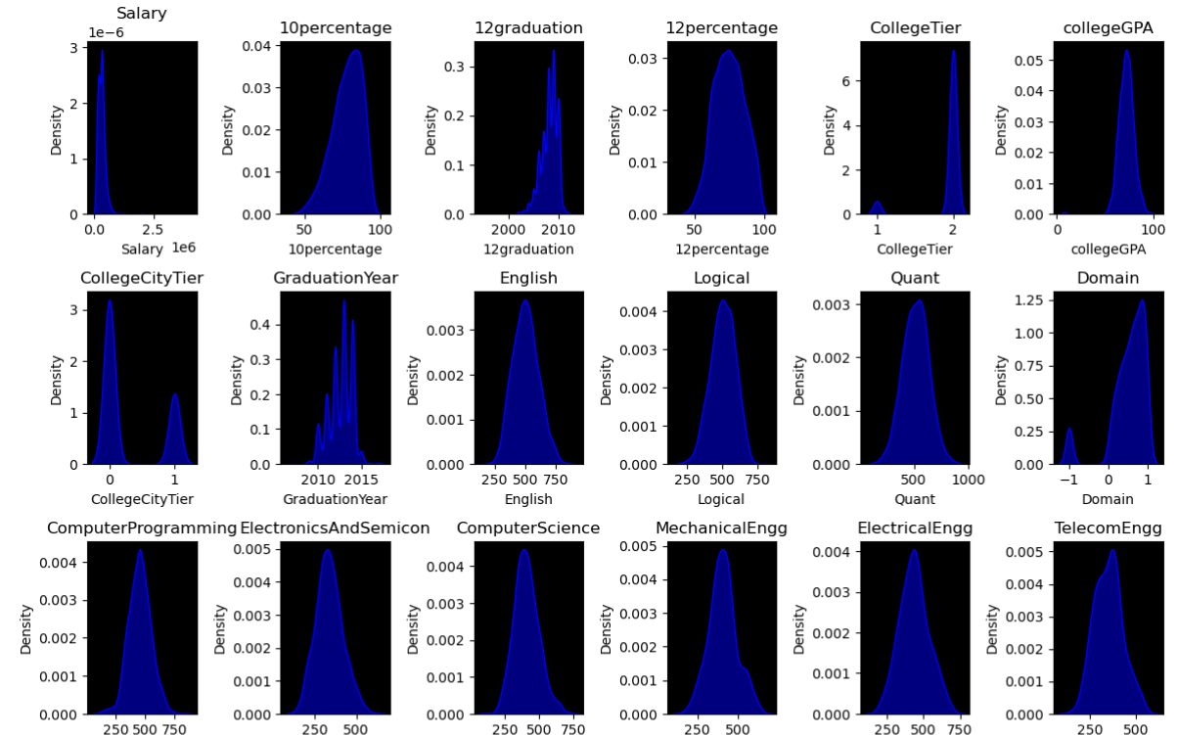
Understanding the frequency distribution using kde-plot

Slide 10
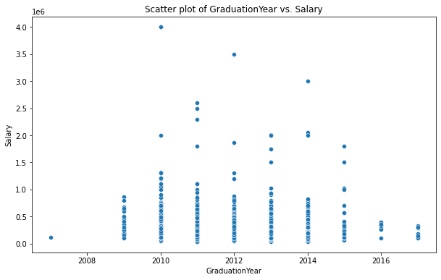
Bivariate Analysis
Insights :
Positive correlation:
There appears to be a positive correlation between graduation year and salary.
This means that, in general,
people who graduated in more recent years earn more than people who graduated in earlier
years.
Numerical Vs Numerical Column

Slide 11
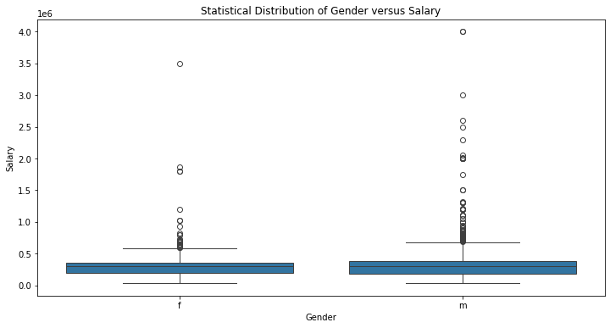
Categorical Column Vs Numerical Column
Insights:
It is clearly visible from
the plot that the Average
salary for men and woman
are looking almost same.
but slightly men are getting
better salary

Slide 12
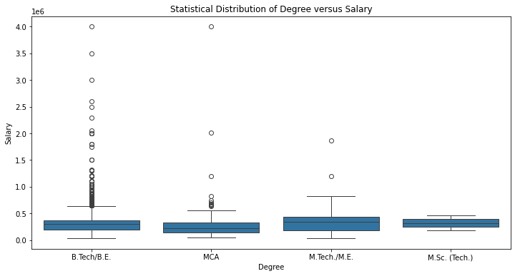
Degree Vs Salary
Insights :
Average salary is highest for
BE / B.Tech graduates
as compared to any other degree
graduates.

Slide 13
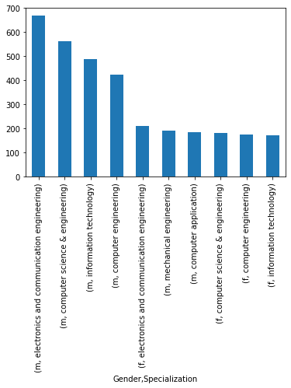
Categorical Vs Categorical Column :
Insights :
As compared to female ,
Male students are getting more jobs from
ECE , CSE & IT .

Slide 14
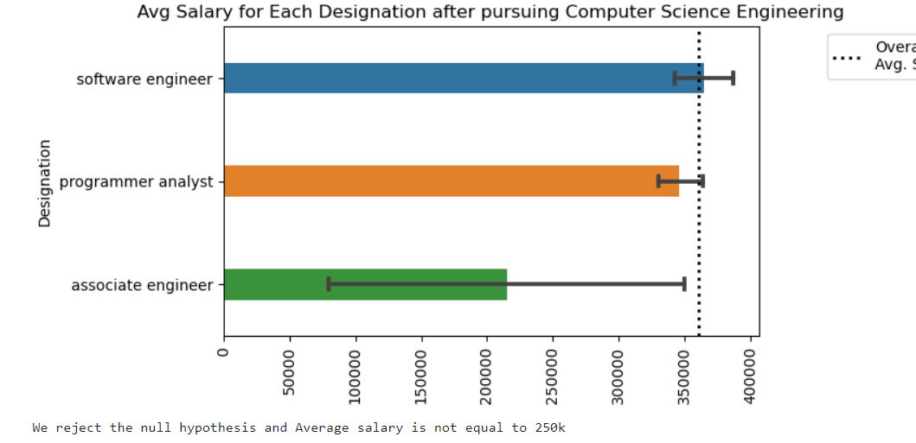
Research Questions
Times of India article dated Jan 18, 2019 states that “After doing your Computer Science Engineering if you
take up jobs as a Programming Analyst, Software Engineer, Hardware Engineer and Associate Engineer you
can earn up to 2.5-3 lakhs as a fresh graduate.” Test this claim with the data given to you.
Insights :
The average salary for each designation after pursuing Computer Science Engineering is not equal to $250,000. The null hypothesis is rejected.
The graph shows the average salary for three different designations: software engineer, programmer analyst, and associate engineer. The average salary for software engineers is the highest, at around $150,000 per year. The average salary for programmer analysts is around $100,000 per year, and the average salary for associate engineers is around $75,000 per year.
It is important to note that these are just average salaries, and there is a wide range of salaries possible for each designation. The salary you can expect to earn will depend on a number of factors, including your experience, education, skills, and the specific company you work for.

Slide 15
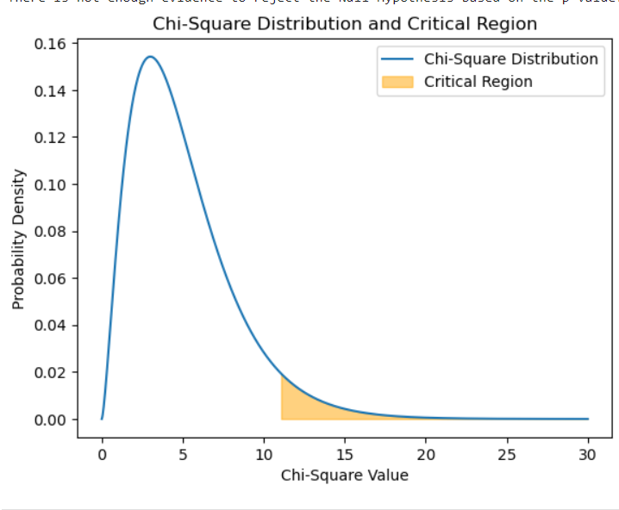
Is there a relationship between gender and specialization? (i.e. Does the preference of Specialisation depend on the Gender?)
The graph shows the probability distribution of a chi-square statistic, which is a statistic used in hypothesis testing to assess how well a sample fits a theoretical distribution. The critical region is a shaded area on the right tail of the distribution, which represents the values of the chi-square statistic that are considered statistically significant. This means that if the calculated chi-square statistic falls within the critical region, we can reject the null hypothesis and conclude that there is a statistically significant difference between the observed data and the theoretical distribution.
The specific values of the critical region depend on the degrees of freedom of the chi-square test, which is not shown in the graph. However, the general shape of the distribution is always skewed to the right, with more probability density on the left side of the graph.

Slide 16
Conclusion
The analysis centres on the Aspiring Mind Employment Outcome 2015 (AMEO) dataset, which provides insights into employment outcomes for engineering graduates.
The dataset encompasses several dependent variables, including Salary, Job Titles, and Job Locations, alongside standardized scores in cognitive, technical, and personality skills.
With approximately 40 independent variables and 4000 data points, the dataset presents a diverse range of continuous and categorical data, augmented by demographic features and unique identifiers for each candidate.
The analysis aims to uncover nuanced insights and correlations, particularly focusing on the interplay between different features and the primary target variable, Salary, with the goal of informing data-driven decision-making processes and understanding factors influencing career trajectories among engineering graduates.
The examination of average salary variations across designations in Computer Science Engineering leads to the rejection of the null hypothesis that the average salary for each designation equals $250,000.
Visualized through a graph, the analysis reveals that software engineers command the highest average salary, followed by programmer analysts and associate engineers. The averages stand at around $150,000, $100,000, and $75,000 per year, respectively.
It's crucial to note that these average figures offer a general overview, and actual salaries are influenced by various factors such as experience, education, skills, and employer specifics.

Slide 17

THANK YOU

